Slide 1


T.C.
MARMARA UNIVERSITY FACULTY of ENGINEERING
CSE4062 Introduction to Data Science and Analytics
Spring 2021
Group #1
Delivery #6: Final Presentation
Title of the Project
Machine Learning Approach to U.S. Stock Investments
Group Members
CSE 150118825 Ahmet Hakan Ekşi ahe9953@gmail.com ENVE 150215036 Canberk Köroğlu canberkkoroglu@hotmail.com ENVE 150215045 Erim Varış ermvrs@live.com
Lecturer
Doç. Dr. Murat Can Ganiz

Slide 2
Project Description
Successful predictions of stock movements have always been utterly important in the market. Billions of dollars were spent in infrastructures and R&D departments in order to predict the future outcomes of share-stocks. Can a computer master the art of finding values in stocks and beat the buy-hold strategies [1]?
It’s no secret that machines are taking up a bigger and bigger share of investing, but the extent of their influence is approaching shocking proportions. It is as high as 80%, according to one major investing firm [2].
This means so much of stock trading is now in the hands of automated buyers and sellers that the market is increasingly sensitive to headlines and more prone to sharp price swings, many notable investors believe [2][3].
Aim of the project is to predict for US stocks future performances by utilizing 200+ indicators and data throughout 2014-2018. Such is that prediction will decide if one should invest or not in a specific stock.

Slide 3
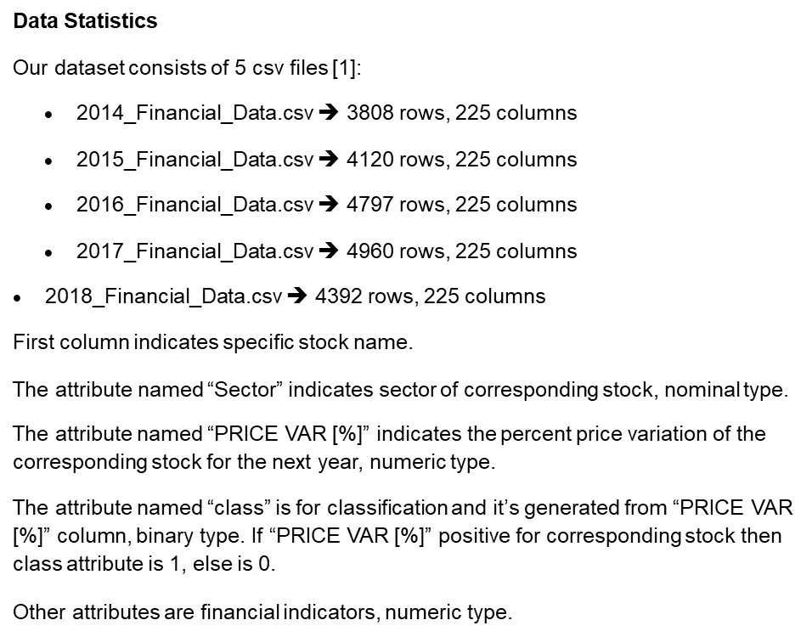

Slide 4
 |  | Feature name | Description |  | Type | Min | Max |  | Avg. | Std.Dev. | Entropy # of values |  | missing values %
0 | Stock |  | stock code | text |  |  |  |  |  |  | 22077 |  | 0
1 Revenue |  |  | financial indicator | numeric_continuous |  | -627616000 |  | 1,88689E+12 | 5161618858 | 31973144008 | 9,6721833 | 20906 | 5,3
2 Revenue Growth |  |  | financial indicator | numeric_continuous |  | -12,7693 |  | 42138,6639 | 3,622214228 | 312,6481703 | 8,7124784 | 19989 | 9,46
3 Cost of Revenue |  |  | financial indicator | numeric_continuous |  | -2986887895 |  | 1,58153E+12 | 3258565393 | 25830920898 | 8,324618 | 20306 | 8,02
4 Gross Profit |  |  | financial indicator | numeric_continuous |  | -12808000000 |  | 4,6216E+11 | 1970452467 | 8735750257 | 9,662554 | 20870 | 5,47
5 R&D Expenses |  |  | financial indicator | numeric_continuous |  | -109800000 |  | 28837000000 | 103333292,3 | 767606165,7 | 4,607591 | 19939 | 9,68
6 SG&A Expense |  |  | financial indicator | numeric_continuous |  | -140159420,3 |  | 1,85683E+11 | 869927885,8 | 3804283410 | 9,7665056 | 20408 | 7,56
7 Operating Expenses |  |  | financial indicator | numeric_continuous |  | -5495511688 |  | 3,05605E+11 | 1368669853 | 5662983943 | 9,9325747 | 20375 | 7,71
8 Operating Income |  |  | financial indicator | numeric_continuous |  | -19339000000 |  | 1,56554E+11 | 589697890,7 | 2976453997 | 9,9155095 | 20976 | 4,99
9 Interest Expense |  |  | financial indicator | numeric_continuous |  | -1710953646 |  | 31523000000 | 97789390,14 | 499654291,6 | 7,713734 | 20358 | 7,79
10 Earnings before Tax |  |  | financial indicator | numeric_continuous |  | -21772000000 |  | 87205000000 | 492500290,6 | 2484345450 | 9,9220695 | 20713 | 6,18
11 Income Tax Expense |  |  | financial indicator | numeric_continuous |  | -7,38E+11 |  | 8,49E+11 | 130002043,9 | 7962080411 | 8,7095261 | 20489 | 7,19
12 Net Income - Non-Controlling int |  |  | financial indicator | numeric_continuous |  | -1587227414 |  | 6430813535 | 13390062,13 | 143753327,2 | 4,1062104 | 19818 | 10,23
13 Net Income - Discontinued ops |  |  | financial indicator | numeric_continuous |  | -15914500000 |  | 8368000000 | -3240313,279 | 242497021,3 | 2,3022106 | 19818 | 10,23
14 Net Income |  |  | financial indicator | numeric_continuous |  | -23045000000 |  | 2,33997E+11 | 388672668,9 | 2643759192 | 9,8886958 | 20512 | 7,09
15 Preferred Dividends |  |  | financial indicator | numeric_continuous |  | -161000000 |  | 2741588000 | 4673906,343 | 53287995,57 | 2,2367805 | 19818 | 10,23
16 Net Income Com |  |  | financial indicator | numeric_continuous |  | -23045000000 |  | 2,33997E+11 | 387125353,8 | 2633920242 | 9,8818891 | 20686 | 6,3
17 EPS |  |  | financial indicator | numeric_continuous |  | -101870898,1 |  | 8028004,014 | -10657,47956 | 896097,6629 | 7,508129 | 20776 | 5,89
18 EPS Diluted |  |  | financial indicator | numeric_continuous |  | -101870898,1 |  | 6624003,312 | -10735,82333 | 895348,7469 | 7,4963166 | 20785 | 5,85
19 Weighted Average Shs Out |  |  | financial indicator | numeric_continuous |  | 0 |  | 1,11292E+11 | 263176678,5 | 2046155695 | 9,8897837 | 20583 | 6,77
20 Weighted Average Shs Out (Dil) |  |  | financial indicator | numeric_continuous |  | 0 |  | 1,11292E+11 | 266492638,3 | 2136719667 | 9,8966135 | 20140 | 8,77
21 Dividend per Share |  |  | financial indicator | numeric_continuous |  | 0 |  | 10100,664 | 1,215391588 | 72,20095121 | 4,4100887 | 19818 | 10,23
22 Gross Margin |  |  | financial indicator | numeric_continuous |  | -74,3191 |  | 31 | 0,487843946 | 0,945601415 | 7,7400683 | 20878 | 5,43
23 EBITDA Margin |  |  | financial indicator | numeric_continuous |  | -24207 |  | 3090,87 | -8,88059069 | 239,6253606 | 7,8290687 | 19630 | 11,08
24 EBIT Margin |  |  | financial indicator | numeric_continuous |  | -24242 |  | 1056,4658 | -7,258787199 | 217,7949818 | 8,8118567 | 20403 | 7,58
25 Profit Margin |  |  | financial indicator | numeric_continuous |  | -24414 |  | 3090,87 | -9,307057101 | 243,2054675 | 7,6178844 | 19633 | 11,07
26 Free Cash Flow margin |  |  | financial indicator | numeric_continuous |  | -23256 |  | 689,8297 | -6,293523163 | 204,8696797 | 8,8038248 | 19786 | 10,38
27 EBITDA |  |  | financial indicator | numeric_continuous |  | -16484000000 |  | 2,33721E+11 | 928982019,4 | 4464530765 | 9,9391423 | 20323 | 7,94
28 EBIT |  |  | financial indicator | numeric_continuous |  | -18713000000 |  | 2,33997E+11 | 616190279,5 | 3324923078 | 9,9046551 | 20652 | 6,45
29 Consolidated Income |  |  | financial indicator | numeric_continuous |  | -23045000000 |  | 2,33997E+11 | 401690839,1 | 2667626334 | 9,894252 | 20510 | 7,1
30 Earnings Before Tax Margin |  |  | financial indicator | numeric_continuous |  | -24202 |  | 1056,4658 | -7,214756216 | 215,1260637 | 8,7144381 | 20882 | 5,41
31 Net Profit Margin |  |  | financial indicator | numeric_continuous |  | -24414 |  | 1056,4658 | -7,28051256 | 218,2950794 | 8,6915063 | 20355 | 7,8
32 Cash and cash equivalents |  |  | financial indicator | numeric_continuous |  | 0 |  | 9,88E+11 | 1894710353 | 21767059845 | 9,8164297 | 20898 | 5,34
33 Short-term investments |  |  | financial indicator | numeric_continuous |  | 0 |  | 8,51E+11 | 1388023358 | 19790342267 | 4,7598229 | 19365 | 12,28
34 Cash and short-term investments |  |  | financial indicator | numeric_continuous |  | 0 |  | 9,88E+11 | 3088980159 | 32984076103 | 9,8889869 | 19602 | 11,21
35 Receivables |  |  | financial indicator | numeric_continuous |  | 0 |  | 9,2E+11 | 976118398,3 | 9746251737 | 8,6234362 | 20972 | 5,01
36 Inventories |  |  | financial indicator | numeric_continuous |  | 0 |  | 9,12E+11 | 504002341,9 | 9014646215 | 6,1520328 | 20246 | 8,29
37 Total current assets |  |  | financial indicator | numeric_continuous |  | 0 |  | 1,26611E+12 | 5381980048 | 46807037160 | 9,9550924 | 19555 | 11,42
38 Property, Plant & Equipment Net |  |  | financial indicator | numeric_continuous |  | 0 |  | 9,72313E+11 | 2714136117 | 17669352472 | 9,5890445 | 20418 | 7,51
39 Goodwill and Intangible Assets |  |  | financial indicator | numeric_continuous |  | 0 |  | 3,8618E+11 | 1731173726 | 8752365896 | 7,7088979 | 20640 | 6,51
40 Long-term investments |  |  | financial indicator | numeric_continuous |  | -80000000 |  | 9,97E+11 | 2930936625 | 34899214793 | 5,5176125 | 19444 | 11,93
41 Tax assets |  |  | financial indicator | numeric_continuous |  | 0 |  | 66501000000 | 152155057,5 | 1216324191 | 5,4985001 | 20094 | 8,98
42 Total non-current assets |  |  | financial indicator | numeric_continuous |  | 0 |  | 5,46381E+16 | 3,40901E+12 | 4,31212E+14 | 9,9585303 | 16055 | 27,28
43 Total assets |  |  | financial indicator | numeric_continuous |  | 0 |  | 2,0357E+13 | 20407238234 | 1,86069E+11 | 9,972989 | 20772 | 5,91
44 Payables |  |  | financial indicator | numeric_continuous |  | -20586351351 |  | 4,24269E+11 | 915984766,1 | 8495931343 | 9,1167398 | 20407 | 7,56
45 Short-term debt |  |  | financial indicator | numeric_continuous |  | -1374631268 |  | 2,75835E+11 | 597883917,1 | 5877180783 | 6,5883925 | 19371 | 12,26
46 Total current liabilities |  |  | financial indicator | numeric_continuous |  | -21077918782 |  | 2,09531E+12 | 7412083756 | 75652859628 | 9,933286 | 19549 | 11,45
47 Long-term debt |  |  | financial indicator | numeric_continuous |  | -8446486486 |  | 4,41253E+12 | 3294063118 | 35331276261 | 8,0306539 | 20169 | 8,64
48 Total debt |  |  | financial indicator | numeric_continuous |  | -9289864865 |  | 4,41253E+12 | 4558784756 | 40661822200 | 8,6129629 | 20369 | 7,74
49 Deferred revenue |  |  | financial indicator | numeric_continuous |  | -23639000 |  | 1,34879E+16 | 6,71468E+11 | 9,51574E+13 | 4,3365589 | 20091 | 9
50 Tax Liabilities |  |  | financial indicator | numeric_continuous |  | -1783580247 |  | 4,93831E+15 | 2,45978E+11 | 3,48269E+13 | 6,058695 | 20106 | 8,93
51 Deposit Liabilities |  |  | financial indicator | numeric_continuous |  | 0 |  | 1,47067E+12 | 5079495680 | 59229049348 | 2,6629876 | 19807 | 10,28
52 Total non-current liabilities |  |  | financial indicator | numeric_continuous |  | -11070540541 |  | 6,17982E+15 | 3,88673E+11 | 4,87933E+13 | 9,718893 | 16041 | 27,34
53 Total liabilities |  |  | financial indicator | numeric_continuous |  | -7872214182 |  | 1,85654E+13 | 16089038257 | 1,67356E+11 | 9,9617698 | 20681 | 6,32
54 Other comprehensive income |  |  | financial indicator | numeric_continuous |  | -94785000000 |  | 1,70852E+15 | 83616099617 | 1,19618E+13 | 7,7625418 | 20401 | 7,59
55 Retained earnings (deficit) |  |  | financial indicator | numeric_continuous |  | -2,8E+11 |  | 7,18E+11 | 2106631255 | 14651964603 | 9,8206735 | 20910 | 5,29
56 Total shareholders equity |  |  | financial indicator | numeric_continuous |  | -22884000000 |  | 1,46573E+12 | 3622994202 | 19618004420 | 9,9493114 | 20705 | 6,21
57 Investments |  |  | financial indicator | numeric_continuous |  | -5283298724 |  | 2,08023E+12 | 9033214981 | 84876067375 | 6,854398 | 20159 | 8,69
58 Net Debt |  |  | financial indicator | numeric_continuous |  | -4,44365E+11 |  | 4,41253E+12 | 1839178489 | 39555328235 | 9,9515545 | 15218 | 31,07
59 Other Assets |  |  | financial indicator | numeric_continuous |  | -9,11987E+11 |  | 7,38599E+11 | 630986068,3 | 19301321722 | 9,7079455 | 15321 | 30,6
60 Other Liabilities |  |  | financial indicator | numeric_continuous |  | -99229000000 |  | 1,86621E+12 | 5885822448 | 69958134200 | 9,5944256 | 19735 | 10,61
61 Depreciation & Amortization |  |  | financial indicator | numeric_continuous |  | -83360000 |  | 7,51E+11 | 342114899,8 | 5474084531 | 9,4327692 | 20549 | 6,92
62 Stock-based compensation |  |  | financial indicator | numeric_continuous |  | -137000000 |  | 9353000000 | 30812480,41 | 213895727,8 | 8,4146136 | 20344 | 7,85
63 Operating Cash Flow |  |  | financial indicator | numeric_continuous |  | -3,4E+11 |  | 9,6E+11 | 1073238607 | 16150911846 | 9,8904069 | 20909 | 5,29
64 Capital Expenditure |  |  | financial indicator | numeric_continuous |  | -1,45585E+11 |  | 5822595000 | -391562278,8 | 2559380997 | 9,3913205 | 20554 | 6,9
65 Acquisitions and disposals |  |  | financial indicator | numeric_continuous |  | -51000000000 |  | 69871000000 | -109483677,8 | 1445095708 | 5,6651598 | 20044 | 9,21
66 Investment purchases and sales |  |  | financial indicator | numeric_continuous |  | -1,93007E+11 |  | 1,49872E+11 | -208487721,3 | 4211286025 | 6,2973138 | 20563 | 6,86
67 Investing Cash ﬂow |  |  | financial indicator | numeric_continuous |  | -1,97993E+11 |  | 1,44591E+11 | -701654255,4 | 4969187220 | 9,7648729 | 20672 | 6,36
68 Issuance (repayment) of debt |  |  | financial indicator | numeric_continuous |  | -1,96353E+11 |  | 62675000000 | 41507146,9 | 3050560787 | 8,4749087 | 20409 | 7,56
69 Issuance (buybacks) of shares |  |  | financial indicator | numeric_continuous |  | -72069000000 |  | 1,44401E+11 | -118415415,6 | 1544792840 | 8,4167144 | 20135 | 8,8
70 Dividend payments |  |  | financial indicator | numeric_continuous |  | -16027206771 |  | 0 | -182172267,1 | 802303602,5 | 5,5747875 | 19921 | 9,77
71 Financing Cash Flow |  |  | financial indicator | numeric_continuous |  | -8,88E+11 |  | 9,98E+11 | -189527124,9 | 15440104591 | 9,8088457 | 21105 | 4,4
72 Eﬀect of forex changes on cash |  |  | financial indicator | numeric_continuous |  | -1E+12 |  | 9,26E+11 | -81866622,34 | 11125329192 | 5,3047296 | 20283 | 8,13
73 Net cash ﬂow / Change in cash |  |  | financial indicator | numeric_continuous |  | -9,88E+11 |  | 9,88E+11 | 115132222,4 | 29486136156 | 9,7145649 | 21059 | 4,61
74 Free Cash Flow |  |  | financial indicator | numeric_continuous |  | -1,04239E+11 |  | 98870000000 | 453355548,5 | 3164032680 | 9,9084494 | 20438 | 7,42
75 Net Cash/Marketcap |  |  | financial indicator | numeric_continuous |  | -4943,5529 |  | 501,7801 | -0,957732926 | 43,20719745 | 9,2474578 | 18721 | 15,2
76 priceBookValueRatio |  |  | financial indicator | numeric_continuous |  | 0 |  | 108458749,3 | 20347,0531 | 1294364,862 | 9,5263397 | 17084 | 22,62
77 priceToBookRatio |  |  | financial indicator | numeric_continuous |  | 0 |  | 108458749,3 | 20344,79097 | 1294364,752 | 8,5494813 | 17084 | 22,62
78 priceToSalesRatio |  |  | financial indicator | numeric_continuous |  | 0 |  | 377315,7961 | 88,04570699 | 3499,317796 | 9,5413237 | 19794 | 10,34
79 priceEarningsRatio |  |  | financial indicator | numeric_continuous |  | 0 |  | 105828,7129 | 37,84104833 | 853,4734956 | 7,2217996 | 19801 | 10,31
80 priceToFreeCashFlowsRatio |  |  | financial indicator | numeric_continuous |  | 0 |  | 60328,7741 | 36,45509543 | 645,7326721 | 7,1538587 | 19800 | 10,31
81 priceToOperatingCashFlowsRatio |  |  | financial indicator | numeric_continuous |  | -108768,6767 |  | 554659,9637 | 53,97084693 | 4242,64938 | 9,8523834 | 18857 | 14,59
82 priceCashFlowRatio |  |  | financial indicator | numeric_continuous |  | 0 |  | 554582,1706 | 63,9417902 | 4537,222149 | 9,8490612 | 15013 | 32
83 priceEarningsToGrowthRatio |  |  | financial indicator | numeric_continuous |  | 0 |  | 100419,288 | 58,40742668 | 954,0306986 | 9,8738942 | 12998 | 41,12
84 priceSalesRatio |  |  | financial indicator | numeric_continuous |  | 0 |  | 377315,7961 | 78,02207275 | 3429,496553 | 9,7666659 | 18720 | 15,21
85 dividendYield |  |  | financial indicator | numeric_continuous |  | 0 |  | 527,926557 | 0,286129491 | 8,332549131 | 6,0343454 | 18779 | 14,94
86 enterpriseValueMultiple |  |  | financial indicator | numeric_continuous |  | 0 |  | 47022,618 | 36,45482558 | 571,1146465 | 10,001333 | 15133 | 31,45
87 priceFairValue |  |  | financial indicator | numeric_continuous |  | 0 |  | 94309693,22 | 11170,94842 | 867520,6729 | 9,8142384 | 18503 | 16,19
88 ebitperRevenue |  |  | financial indicator | numeric_continuous |  | -24242 |  | 1056,465753 | -7,751022894 | 224,4290589 | 9,9067423 | 19215 | 12,96
89 ebtperEBIT |  |  | financial indicator | numeric_continuous |  | -983,2076923 |  | 2263,870095 | 0,634464077 | 21,47880022 | 8,7069032 | 14070 | 36,27
90 niperEBT |  |  | financial indicator | numeric_continuous |  | -206,0833333 |  | 845,5555556 | 0,864169005 | 9,535127399 | 9,7375853 | 13482 | 38,93
91 grossProfitMargin |  |  | financial indicator | numeric_continuous |  | -223,4827586 |  | 34,81074705 | 0,492200918 | 2,023480525 | 8,759676 | 19215 | 12,96
92 operatingProfitMargin |  |  | financial indicator | numeric_continuous |  | 1 |  | 1 | 1 | 0 | 1,4175145 | 19215 | 12,96
93 pretaxProfitMargin |  |  | financial indicator | numeric_continuous |  | -24577 |  | 198,6842105 | -8,055263164 | 225,9547824 | 10,000674 | 19215 | 12,96
94 netProfitMargin |  |  | financial indicator | numeric_continuous |  | -24414 |  | 1056,465753 | -7,781141393 | 224,6994764 | 9,8934873 | 19215 | 12,96
95 eﬀectiveTaxRate |  |  | financial indicator | numeric_continuous |  | -28384,61538 |  | 207,0833333 | -2,003388331 | 244,6404842 | 9,7303662 | 13482 | 38,93
96 returnOnAssets |  |  | financial indicator | numeric_continuous |  | -344,4375 |  | 345,631 | -0,065041893 | 8,362792694 | 9,45363 | 15542 | 29,6
97 returnOnEquity |  |  | financial indicator | numeric_continuous |  | -34772,4596 |  | 11141141,67 | 1645,940434 | 114822,1261 | 8,9870833 | 19739 | 10,59
98 returnOnCapitalEmployed |  |  | financial indicator | numeric_continuous |  | -616,6446 |  | 3863,9037 | -0,115455492 | 35,25907382 | 8,7565089 | 15568 | 29,48
99 nIperEBT |  |  | financial indicator | numeric_continuous |  | -206,0833333 |  | 845,5555556 | 0,864169005 | 9,535127399 | 9,7375853 | 13482 | 38,93
100 eBTperEBIT |  |  | financial indicator | numeric_continuous |  | -983,2076923 |  | 2263,870095 | 0,634464077 | 21,47880022 | 8,7069032 | 14070 | 36,27
101 eBITperRevenue |  |  | financial indicator | numeric_continuous |  | -24242 |  | 1056,465753 | -7,751022894 | 224,4290589 | 9,9067423 | 19215 | 12,96
102 payablesTurnover |  |  | financial indicator | numeric_continuous |  | -41,0958 |  | 8650,3158 | 6,213959035 | 79,57121081 | 9,0141761 | 17166 | 22,24
103 inventoryTurnover |  |  | financial indicator | numeric_continuous |  | 0 |  | 95827,7103 | 31,62418604 | 727,3354978 | 6,3488777 | 19565 | 11,38
104 fixedAssetTurnover |  |  | financial indicator | numeric_continuous |  | -383,600635 |  | 446511,8571 | 90,56735173 | 4343,27676 | 9,7395528 | 18943 | 14,2
105 assetTurnover |  |  | financial indicator | numeric_continuous |  | -0,125107358 |  | 134,3659007 | 0,691155034 | 1,252066062 | 9,6869601 | 19933 | 9,71
106 currentRatio |  |  | financial indicator | numeric_continuous |  | -1,4393 |  | 20590,47 | 7,117724292 | 183,9802989 | 9,2348108 | 19012 | 13,88
107 quickRatio |  |  | financial indicator | numeric_continuous |  | 0 |  | 486211,2845 | 71,87380198 | 5133,271127 | 10,000761 | 19019 | 13,85
108 cashRatio |  |  | financial indicator | numeric_continuous |  | 0 |  | 164465,7863 | 19,00038241 | 1686,668794 | 9,9883058 | 19019 | 13,85
109 daysOfSalesOutstanding |  |  | financial indicator | numeric_continuous |  | -5182867,019 |  | 975,8069 | -402,0754599 | 37239,23272 | 6,1547221 | 19835 | 10,16
110 daysOfInventoryOutstanding |  |  | financial indicator | numeric_continuous |  | -473104,3422 |  | 3900070,847 | 602,3590147 | 39376,95708 | 8,6774324 | 20168 | 8,65
111 operatingCycle |  |  | financial indicator | numeric_continuous |  | 68,4745 |  | 1077,7422 | 176,3765158 | 220,1073186 | 10,002292 | 19 | 99,91
112 daysOfPayablesOutstanding |  |  | financial indicator | numeric_continuous |  | -207232,4715 |  | 1043413,33 | 340,3941996 | 9865,965792 | 8,9073255 | 19840 | 10,13
113 cashConversionCycle |  |  | financial indicator | numeric_continuous |  | -262,6048 |  | 375,998 | 43,85739474 | 131,6433214 | 10,002292 | 19 | 99,91
114 debtRatio |  |  | financial indicator | numeric_continuous |  | -0,4536 |  | 133,6571 | 0,272899231 | 1,135444257 | 7,9146035 | 19763 | 10,48
115 debtEquityRatio |  |  | financial indicator | numeric_continuous |  | -2586,4359 |  | 2131,5128 | 0,562818691 | 26,65730955 | 8,3934875 | 19763 | 10,48
116 longtermDebtToCapitalization |  |  | financial indicator | numeric_continuous |  | -1,930983348 |  | 91,03812317 | 0,359341565 | 1,229186324 | 8,036944 | 19688 | 10,82
117 totalDebtToCapitalization |  |  | financial indicator | numeric_continuous |  | -2,736131494 |  | 1040,047427 | 0,453077447 | 7,519624712 | 8,3612482 | 19785 | 10,38

Slide 5
116 longtermDebtToCapitalization | financial indicator | numeric_continuous | -1,930983348 | 91,03812317 | 0,359341565 | 1,229186324 8,036944 | 19688 | 10,82
117 totalDebtToCapitalization | financial indicator | numeric_continuous | -2,736131494 | 1040,047427 | 0,453077447 | 7,519624712 8,3612482 | 19785 | 10,38
118 interestCoverage | financial indicator | numeric_continuous | -223603 | 361207,3684 | -32,19756542 | 3781,263307 8,0033936 | 19890 | 9,91
119 cashFlowToDebtRatio | financial indicator | numeric_continuous | -40783,94035 | 863187,7715 | 67,17364654 | 6929,147805 10,000608 | 15801 | 28,43
120 companyEquityMultiplier | financial indicator | numeric_continuous | 0,274651772 | 8740761,333 | 1232,574918 | 82998,64085 10,000734 | 18742 | 15,11
121 operatingCashFlowPerShare | financial indicator | numeric_continuous | -24942284,42 | 45351079,16 | 22904,80882 | 763234,3879 9,8919232 | 19652 | 10,98
122 freeCashFlowPerShare | financial indicator | numeric_continuous | -35588921,28 | 31932634,45 | 1507,182944 | 405433,7599 9,394083 | 19653 | 10,98
123 cashPerShare | financial indicator | numeric_continuous | 0 | 212722714,2 | 83671,83018 | 3097123,515 9,8022353 | 19648 | 11
124 payoutRatio | financial indicator | numeric_continuous | -137,154 | 479,57 | 0,323305308 | 5,961775615 5,0139712 | 19687 | 10,83
125 operatingCashFlowSalesRatio | financial indicator | numeric_continuous | -1432432,432 | 377383,592 | -11,8965239 | 11384,22305 10,000483 | 19215 | 12,96
126 freeCashFlowOperatingCashFlowRatio | financial indicator | numeric_continuous | -11849,1722 | 47,65294118 | -0,698318457 | 95,61367088 9,7651818 | 15489 | 29,84
127 cashFlowCoverageRatios | financial indicator | numeric_continuous | -40783,94035 | 863187,7715 | 67,17364654 | 6929,147805 10,000608 | 15801 | 28,43
128 shortTermCoverageRatios | financial indicator | numeric_continuous | -16336,66671 | 863187,7715 | 254,5972607 | 10450,29591 10,000651 | 11333 | 48,67
129 capitalExpenditureCoverageRatios | financial indicator | numeric_continuous | -46880 | 313315,6667 | -13,60738533 | 2438,368584 9,9996934 | 18428 | 16,53
130 dividendpaidAndCapexCoverageRatios | financial indicator | numeric_continuous | -46880 | 64384,91318 | -33,93732918 | 764,973657 10,000282 | 19157 | 13,23
131 dividendPayoutRatio | financial indicator | numeric_continuous | 0 | 746,7014925 | 0,821236148 | 10,69369456 8,2620207 | 12998 | 41,12
132 Revenue per Share | financial indicator | numeric_continuous | -3,1677 | 226232494,9 | 151639,5713 | 4206785,552 9,6799405 | 19634 | 11,07
133 Net Income per Share | financial indicator | numeric_continuous | -12724877,5 | 29790471,67 | 12909,93628 | 485543,6331 9,8550752 | 19632 | 11,07
134 Operating Cash Flow per Share | financial indicator | numeric_continuous | -24942284,42 | 45351079,16 | 22890,83379 | 763001,6673 9,8918604 | 19664 | 10,93
135 Free Cash Flow per Share | financial indicator | numeric_continuous | -35588921,28 | 31932634,45 | 1506,262306 | 405310,0343 9,394083 | 19665 | 10,93
136 Cash per Share | financial indicator | numeric_continuous | 0 | 212722714,2 | 83676,08894 | 3097202,28 9,8023372 | 19647 | 11,01
137 Book Value per Share | financial indicator | numeric_continuous | -642647,391 | 616362318,8 | 57141,16336 | 4686263,306 9,7298416 | 19646 | 11,01
138 Tangible Book Value per Share | financial indicator | numeric_continuous | 0 | 1095289855 | 108896,1331 | 8442215,673 9,8452834 | 19646 | 11,01
139 Shareholders Equity per Share | financial indicator | numeric_continuous | -660561,1875 | 258351241,9 | 202814,8394 | 4956871,317 9,9639907 | 19647 | 11,01
140 Interest Debt per Share | financial indicator | numeric_continuous | -20,0091 | 419924840,9 | 319578,2413 | 8965197,118 8,6638437 | 19646 | 11,01
141 Market Cap | financial indicator | numeric_continuous | 0 | 9,6192E+13 | 30560346775 | 1,43251E+12 9,9018012 | 19006 | 13,91
142 Enterprise Value | financial indicator | numeric_continuous | -1,48755E+11 | 1,14583E+12 | 8478816749 | 32731994168 9,8081561 | 17037 | 22,83
143 PE ratio | financial indicator | numeric_continuous | 0 | 105828,7129 | 37,90369287 | 852,9069156 7,2160316 | 19829 | 10,18
144 Price to Sales Ratio | financial indicator | numeric_continuous | 0 | 377315,7961 | 87,95396542 | 3496,848241 9,5389403 | 19822 | 10,21
145 POCF ratio | financial indicator | numeric_continuous | -108768,6767 | 554659,9637 | 53,91658057 | 4240,064551 9,8503022 | 18880 | 14,48
146 PFCF ratio | financial indicator | numeric_continuous | 0 | 60328,7741 | 36,42683441 | 645,2775071 7,148715 | 19828 | 10,19
147 PB ratio | financial indicator | numeric_continuous | 0 | 108458749,3 | 20328,1694 | 1293759,281 9,524482 | 17100 | 22,54
148 PTB ratio | financial indicator | numeric_continuous | 0 | 108458749,3 | 20325,9089 | 1293759,171 8,5457427 | 17100 | 22,54
149 EV to Sales | financial indicator | numeric_continuous | -4324,8114 | 185096,2978 | 53,71533787 | 1675,346125 9,4997363 | 17030 | 22,86
150 Enterprise Value over EBITDA | financial indicator | numeric_continuous | 0 | 35296,196 | 21,73107447 | 308,2014987 8,3296498 | 17034 | 22,84
151 EV to Operating cash ﬂow | financial indicator | numeric_continuous | -94684,1767 | 512579,0405 | 40,0733114 | 4017,128639 9,791063 | 17034 | 22,84
152 EV to Free cash ﬂow | financial indicator | numeric_continuous | -467933,3193 | 84994,8903 | -19,47912927 | 3988,397694 9,8003732 | 17034 | 22,84
153 Earnings Yield | financial indicator | numeric_continuous | -21375 | 12673,4414 | -0,215082702 | 219,1828341 8,3875114 | 19829 | 10,18
154 Free Cash Flow Yield | financial indicator | numeric_continuous | -25896,7081 | 293,8176 | -1,735278236 | 191,1058846 8,5980376 | 18880 | 14,48
155 Debt to Equity | financial indicator | numeric_continuous | -2586,4359 | 2131,5128 | 0,562818691 | 26,65730955 8,3934875 | 19763 | 10,48
156 Debt to Assets | financial indicator | numeric_continuous | -0,4536 | 133,6571 | 0,272899231 | 1,135444257 7,9146035 | 19763 | 10,48
157 Net Debt to EBITDA | financial indicator | numeric_continuous | -9616 | 22776,5294 | 2,882300912 | 236,6003344 9,9460444 | 14362 | 34,95
158 Current ratio | financial indicator | numeric_continuous | -1,4393 | 20590,47 | 6,578997558 | 190,4739662 9,2353996 | 15561 | 29,51
159 Interest Coverage | financial indicator | numeric_continuous | -223603 | 361207,3684 | -32,077465 | 3778,42755 7,999442 | 19920 | 9,77
160 Income Quality | financial indicator | numeric_continuous | -2719,5 | 17675,5 | 2,821206668 | 136,3167276 9,7831828 | 19857 | 10,06
161 Dividend Yield | financial indicator | numeric_continuous | 0 | 14,55 | 0,020425596 | 0,143164399 4,5387377 | 19831 | 10,17
162 Payout Ratio | financial indicator | numeric_continuous | -137,154 | 479,57 | 0,323061214 | 5,958608477 5,0055525 | 19708 | 10,73
163 SG&A to Revenue | financial indicator | numeric_continuous | -58,7976 | 15246 | 3,50988637 | 122,9899733 8,6307245 | 19853 | 10,07
164 R&D to Revenue | financial indicator | numeric_continuous | -0,7317 | 12991 | 4,445070404 | 128,8361591 4,0602287 | 19800 | 10,31
165 Intangibles to Total Assets | financial indicator | numeric_continuous | 0 | 0,9953 | 0,154727445 | 0,209260006 7,0200682 | 19880 | 9,95
166 Capex to Operating Cash Flow | financial indicator | numeric_continuous | 0 | 11850,1722 | 1,386501778 | 84,31568267 7,4266056 | 19967 | 9,56
167 Capex to Revenue | financial indicator | numeric_continuous | -4310 | 773,6667 | 0,12848176 | 31,98942754 7,6309164 | 19868 | 10,01
168 Capex to Depreciation | financial indicator | numeric_continuous | -28088,9763 | 35298,3333 | -5,526198988 | 372,6075808 9,2122073 | 19852 | 10,08
169 Stock-based compensation to Revenue | financial indicator | numeric_continuous | -5,7684 | 3700 | 1,079116527 | 33,51364236 6,3588676 | 19774 | 10,43
170 Graham Number | financial indicator | numeric_continuous | 0 | 8851965,516 | 737,5825845 | 69208,74595 7,8487315 | 17094 | 22,57
171 ROIC | financial indicator | numeric_continuous | -616,6446 | 3863,9037 | -0,115455492 | 35,25907382 8,7565089 | 15568 | 29,48
172 Return on Tangible Assets | financial indicator | numeric_continuous | -344,4375 | 345,631 | -0,065041893 | 8,362792694 9,45363 | 15542 | 29,6
173 Graham Net-Net | financial indicator | numeric_continuous | -5474,4406 | 283,0389 | -1,659189271 | 45,88340617 9,3533211 | 18911 | 14,34
174 Working Capital | financial indicator | numeric_continuous | -4,61001E+15 | 1,47214E+13 | -2,88121E+11 | 3,69499E+13 9,9755616 | 15567 | 29,49
175 Tangible Asset Value | financial indicator | numeric_continuous | -24215000000 | 2,56818E+12 | 16164888181 | 1,10548E+11 9,993728 | 19880 | 9,95
176 Net Current Asset Value | financial indicator | numeric_continuous | -1,37794E+12 | 80512000000 | -7585341634 | 56846491891 9,9887559 | 19046 | 13,73
177 Invested Capital | financial indicator | numeric_continuous | -8,26288E+15 | 3,0528E+12 | -4,00379E+11 | 5,87784E+13 9,9939914 | 19762 | 10,49
178 Average Receivables | financial indicator | numeric_continuous | 0 | 4,60003E+11 | 914402488,4 | 6902478102 8,8585767 | 19948 | 9,64
179 Average Payables | financial indicator | numeric_continuous | -20369190904 | 7,1236E+11 | 950983534,7 | 10140227058 9,2630179 | 19651 | 10,99
180 Average Inventory | financial indicator | numeric_continuous | 0 | 4,56E+11 | 392181094,2 | 3875869753 6,3487377 | 19646 | 11,01
181 Days Sales Outstanding | financial indicator | numeric_continuous | -473104,3422 | 3900070,847 | 747,5486148 | 42585,473 8,6779108 | 20238 | 8,33
182 Days Payables Outstanding | financial indicator | numeric_continuous | -207232,4715 | 1043413,33 | 340,4278665 | 9866,462561 8,9077961 | 19838 | 10,14
183 Days of Inventory on Hand | financial indicator | numeric_continuous | -5182867,019 | 975,8069 | -402,1160061 | 37241,11019 6,1556404 | 19833 | 10,16
184 Receivables Turnover | financial indicator | numeric_continuous | -8698,6061 | 164428,5 | 44,77226775 | 1687,815259 8,7340214 | 19864 | 10,02
185 Payables Turnover | financial indicator | numeric_continuous | -41,0958 | 8650,3158 | 6,213959035 | 79,57121081 9,0141761 | 17166 | 22,24
186 Inventory Turnover | financial indicator | numeric_continuous | 0 | 95827,7103 | 31,62418604 | 727,3354978 6,3488777 | 19565 | 11,38
187 ROE | financial indicator | numeric_continuous | -34772,4596 | 11141141,67 | 1646,107283 | 114827,9427 8,9871461 | 19737 | 10,6
188 Capex per Share | financial indicator | numeric_continuous | -73354000 | 1255872,972 | -18800,31495 | 662354,255 9,1777569 | 19664 | 10,93
189 Gross Profit Growth | financial indicator | numeric_continuous | -5536,4833 | 336767,8 | 18,95154469 | 2380,55765 8,8223452 | 20069 | 9,1
190 EBIT Growth | financial indicator | numeric_continuous | -16888 | 20598,4286 | 0,807739501 | 233,2634268 9,5673168 | 19736 | 10,6
191 Operating Income Growth | financial indicator | numeric_continuous | -18881 | 13545,3387 | 0,462037376 | 188,4220477 9,5187312 | 20109 | 8,91
192 Net Income Growth | financial indicator | numeric_continuous | -33777 | 3159 | -2,230353811 | 248,959622 9,6459386 | 19695 | 10,79
193 EPS Growth | financial indicator | numeric_continuous | -2125 | 4378,0492 | 0,28336706 | 37,74877337 9,2935033 | 19894 | 9,89
194 EPS Diluted Growth | financial indicator | numeric_continuous | -2125 | 39679767,04 | 1995,812966 | 281395,5581 9,2892832 | 19884 | 9,93
195 Weighted Average Shares Growth | financial indicator | numeric_continuous | -0,9999 | 223089,5 | 13,20897567 | 1611,269005 8,1611523 | 19269 | 12,72
196 Weighted Average Shares Diluted Growth | financial indicator | numeric_continuous | -1 | 3378329,472 | 189,6109702 | 25075,11989 8,3011882 | 18155 | 17,77
197 Dividends per Share Growth | financial indicator | numeric_continuous | -1 | 372,5714 | 0,15822221 | 3,502421548 4,2221884 | 19608 | 11,18
198 Operating Cash Flow growth | financial indicator | numeric_continuous | -18001 | 455999 | 64,1095843 | 5239,628223 9,5373236 | 20014 | 9,34
199 Free Cash Flow growth | financial indicator | numeric_continuous | -83431,4286 | 8030,3333 | -3,544641565 | 603,6085433 9,6935924 | 19603 | 11,21
200 10Y Revenue Growth (per Share) | financial indicator | numeric_continuous | -1 | 1,747 | 0,021050618 | 0,156278714 9,1178861 | 12545 | 43,18
201 5Y Revenue Growth (per Share) | financial indicator | numeric_continuous | -1 | 8,9762 | 0,028228113 | 0,23575332 8,8964722 | 15676 | 28,99
202 3Y Revenue Growth (per Share) | financial indicator | numeric_continuous | -1 | 43,9195 | 0,04070423 | 0,508011672 8,756619 | 17611 | 20,23
203 10Y Operating CF Growth (per Share) | financial indicator | numeric_continuous | -0,7618 | 1,7327 | 0,037765569 | 0,115318076 8,3930886 | 12599 | 42,93
204 5Y Operating CF Growth (per Share) | financial indicator | numeric_continuous | -1 | 4,1862 | 0,04725043 | 0,197747276 7,9154553 | 15713 | 28,83
205 3Y Operating CF Growth (per Share) | financial indicator | numeric_continuous | -1 | 9,6961 | 0,064219315 | 0,316339779 7,5719552 | 17644 | 20,08
206 10Y Net Income Growth (per Share) | financial indicator | numeric_continuous | -1 | 1,3372 | 0,030847493 | 0,11101356 7,9262918 | 12545 | 43,18
207 5Y Net Income Growth (per Share) | financial indicator | numeric_continuous | -1 | 4,4761 | 0,0569213 | 0,204218394 7,1267944 | 15676 | 28,99
208 3Y Net Income Growth (per Share) | financial indicator | numeric_continuous | -1 | 17,0282 | 0,072422957 | 0,375422568 6,7738537 | 17611 | 20,23
209 10Y Shareholders Equity Growth (per Share) | financial indicator | numeric_continuous | -0,7137 | 2,451 | 0,033468202 | 0,126555696 9,0231715 | 12397 | 43,85
210 5Y Shareholders Equity Growth (per Share) | financial indicator | numeric_continuous | -0,8874 | 6,0316 | 0,039181994 | 0,203913496 8,6958194 | 15467 | 29,94
211 3Y Shareholders Equity Growth (per Share) | financial indicator | numeric_continuous | -0,981 | 20,0367 | 0,047642119 | 0,386584146 8,5730066 | 17434 | 21,03
212 10Y Dividend per Share Growth (per Share) | financial indicator | numeric_continuous | -1 | 0,9128 | -0,026189597 | 0,229555076 6,8082258 | 12900 | 41,57
213 5Y Dividend per Share Growth (per Share) | financial indicator | numeric_continuous | -1 | 2,9811 | -0,000595742 | 0,229905763 5,543252 | 16299 | 26,17
214 3Y Dividend per Share Growth (per Share) | financial indicator | numeric_continuous | -1 | 5,4005 | 0,01229793 | 0,263079291 4,885649 | 18264 | 17,27
215 Receivables growth | financial indicator | numeric_continuous | -1 | 153332,3333 | 10,97823889 | 1101,098165 8,1732668 | 19952 | 9,63
216 Inventory Growth | financial indicator | numeric_continuous | -1 | 293,473 | 0,158858254 | 3,268153782 5,9121922 | 19650 | 10,99
217 Asset Growth | financial indicator | numeric_continuous | -1 | 5468,4264 | 1,134220838 | 45,38107936 8,9476856 | 19690 | 10,81
218 Book Value per Share Growth | financial indicator | numeric_continuous | -3963,1312 | 7039,3259 | 0,783208338 | 66,52400566 9,1425259 | 19213 | 12,97
219 Debt Growth | financial indicator | numeric_continuous | -1,051 | 17646,8235 | 3,733922197 | 174,8647006 7,9443619 | 19462 | 11,84
220 R&D Expense Growth | financial indicator | numeric_continuous | -2,6622 | 1542,611 | 0,295609613 | 12,97412737 4,5681472 | 19598 | 11,23
221 SG&A Expenses Growth | financial indicator | numeric_continuous | -2,3699 | 2042 | 0,365149021 | 15,03005424 8,8285163 | 19655 | 10,97
 | specified sector of
222 Sector | selected company | nominal | Communication Services | Financial Services |  | 2,1877003 | 22077 | 0
 | stock
 | annual stock value
223 PRICE VAR NEXT YEAR
variation for following year in percent
numeric_continuous
-100,3972195
2418600,915
269,8892659
19346,1736 9,9909845
22077
0
224 Class
indicator for decision making
with respect to price boolean var value being
positive or negative
22077
0
225 Year
selected year of stock performance
nominal 2014 2017 1,6048029 22077
0
Disclaimer: If you are having difficulties reading the table. Excel file is included in GitHub

Slide 6
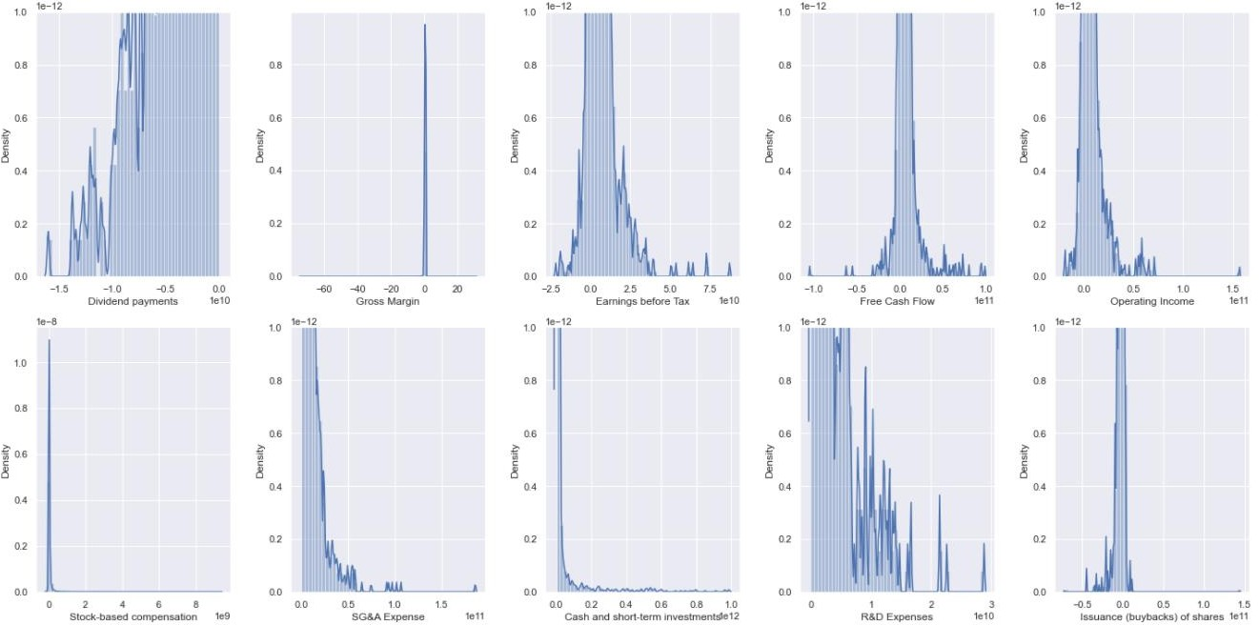
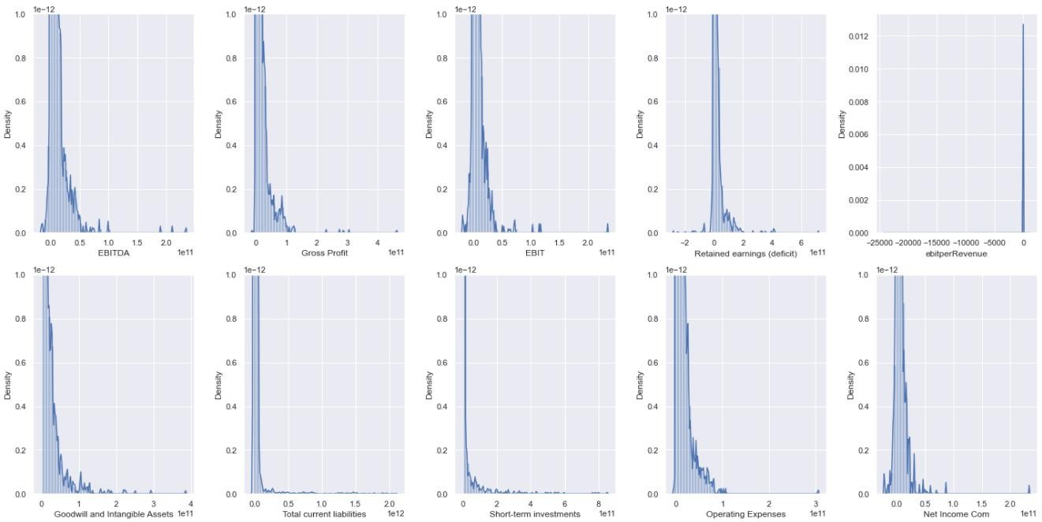
1- Feature Selection & Charts
We have 225 features. One of them is for classification, one of them for generating class label, one of them is year, one of them is the Stock ID. There are 221 features left. One is nominal/categorical feature that specifies companies’ sector. Other 220 features are financial indicator and all of them is numerical attribute.
Our data has considerable number of missing values. Therefore, in feature selection we first drop the attributes that has more than 33% missing values, 16 attributes. There are 206 attributes left. And then we replace missing values with mean value of attributes, considering each sector individually.
In final we choose our best 20 attributes by using ANOVA F-value. We also try with Mutual Information but with MI, our 20 attributes’ missing values percentages before replacing as very close to our threshold 33%. We want to use more raw data; therefore, we choose ANOVA F-value for feature selection.
Fig. 1. Distribution charts

Slide 7
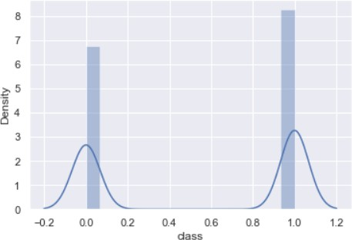
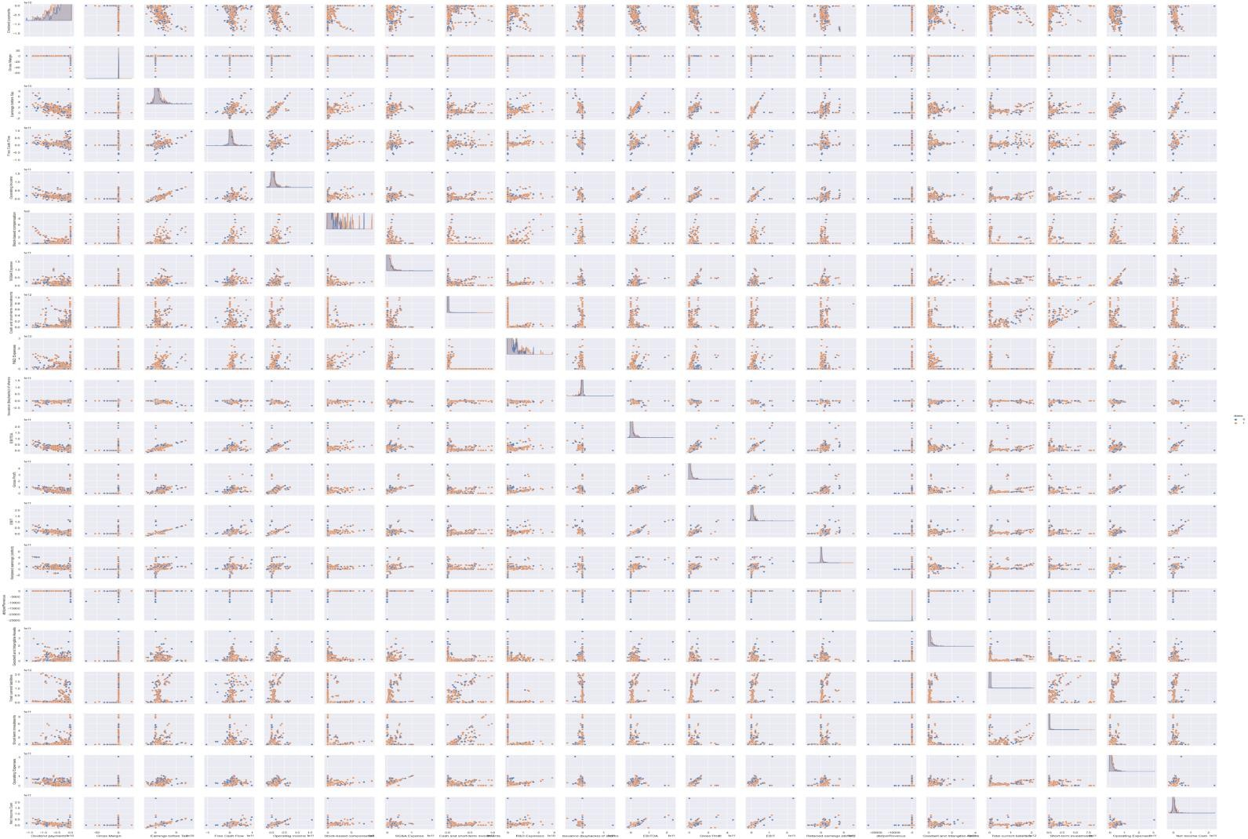
Fig. 2. Class Distribution chart
This is our class labels density chart. As you can see from the chart our stocks prices most likely to increase next year.
2- Scatter Plot Matrix
Fig. 3. Scatter Plot Matrix
In Figure 3 relationships between financial indicators are observed. X-axis shows a specific indicator, and y-axis shows another indicator, and the plot shows their relationships. Interactions between these indicators are mostly positively correlated for e.g. (3,6) or negatively correlated for e.g. (17,17) due to slopes being either negative or positive.

Slide 8
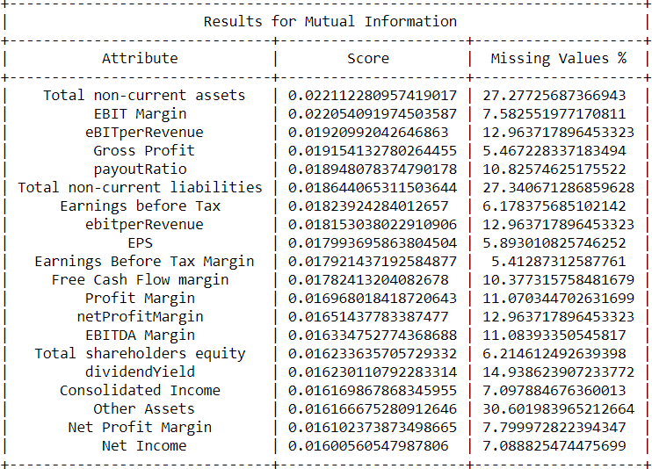
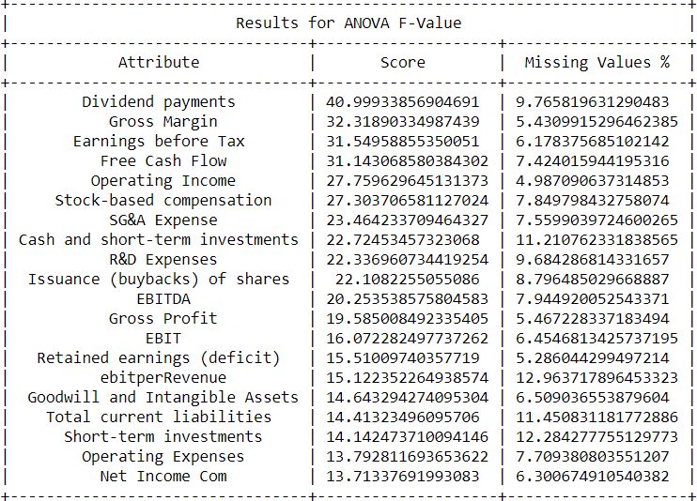
1- Feature Selection Methods
Due to data having large numbers of missing values we drop the attributes that has more than 33% missing values and we replace missing values with mean value of attributes.
Table 1. Mutual Information
Table 2. ANOVA F-Value

Slide 9
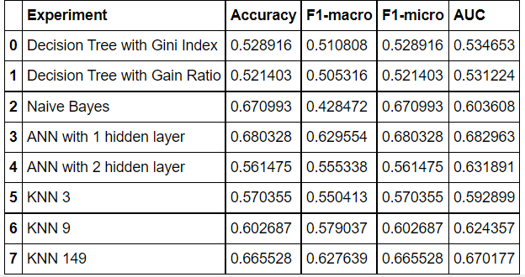
To conclude we choose our best 20 attributes by using ANOVA F-value. We also try with Mutual Information but with MI, our 20 attributes with missing value percentages before replacing gets very close to our threshold of 33%. We want to use more raw data; therefore, we choose ANOVA F-value for feature selection.
Classification Experiments
We did not use Cross Validation or any other similar methods alike. We split our train and test set according to years. Last year’s csv, 2018, is our test set.
The reasoning behind this is we thought ourselves at the end of 2018 and wanted to profit next year by using the algorithm. Thus, we use features selected in ANOVA F-Value.
Methods used for classification in this experiment;
Decision Tree with Gini Index which is calculated by subtracting the sum of squared probabilities of each class from one.
Decision Tree with Gain Ratio which determines the information gain of all the attributes, and then computes the average information gain.
Naïve Bayes which are based on applying Bayes' theorem with strong independence assumptions between the features.
Artificial Neural Networks which are designed to simulate the way the human brain analyzes and processes information.
K Nearest Neighbor assumes that similar things exist in close proximity.
Table 3. Table for Evaluation for Classification Experiments
The performance evaluation table shows the most accurate method is ANN with 1 hidden layer. Considering Area Under Curve (AUC) which measures performance across all possible classification thresholds it suggests ANN with 1 hidden layer overperforms when compared with Naïve-Bayes which is also less accurate. Also, F1-micro (micro-averages) suggests ANN with 1 hidden layer performs better. Furthermore, F1-macro (macro-averages) indicate ANN with 1 hidden layer performs better.

Slide 10
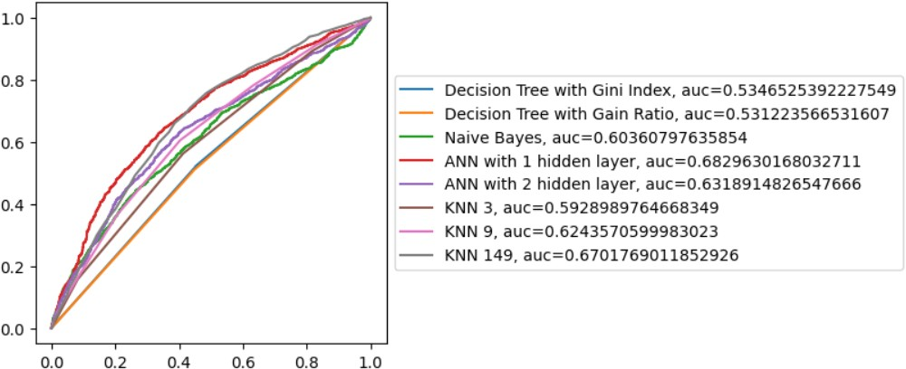
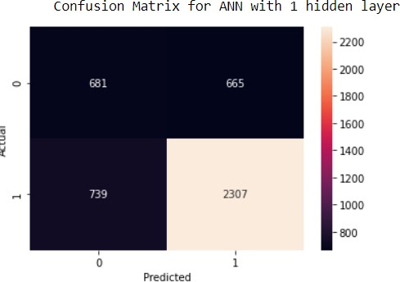
Fig.1 ROC Curve
The ROC curve shows the trade-off between sensitivity and specificity. Classifiers that give curves closer to the top-left corner indicate a better performance. The closer the curve comes to the 45-degree diagonal of the ROC space, the less accurate the test. This also shows ANN with 1 hidden layer is the best performing method followed by Naïve-Bayes.
Fig.2 Confusion Matrix for ANN with 1 hidden layer
In Figure.2 it is observed that ANN with 1 hidden layer method predicted true positive cases 2307 times out of 4392 cases and true negative cases 681 times.
This suggests 68% of the algorithm is classifying correctly. Even though theoretically any algorithm can reach 100% accuracy, our achievement of 68% is good enough. Case being that if this algorithm reached maximum accuracy Group-1 would probably be very rich next year because of this achievement.

Slide 11
5- Statistical significance analysis between your best performing model and its closest competitor
Best Model: ANN with 1 hidden layer, Closest Competitor: Naïve-Bayes Accuracy:
The P-value is = 0.002 The t-statistics is = 5.914
Since p<0.05, We can reject the null-hypothesis in terms of accuracy that both models perform equally well on this dataset. We may conclude that the two algorithms are significantly different.
F1-Macro:
The P-value is = 0.005 The t-statistics is = 4.883
Since p<0.05, We can reject the null-hypothesis in terms of f1_macro that both models perform equally well on this dataset. We may conclude that the two algorithms are significantly different.
F1-Micro:
The P-value is = 0.059 The t-statistics is = 2.428
Since p>0.05, we cannot reject the null hypothesis in terms of f1_micro may conclude that the performance of the two algorithms is not significantly different.
AUC:
The P-value is = 0.398 The t-statistics is = -0.923
Since p>0.05, we cannot reject the null hypothesis in terms of AUC and may conclude that the performance
of the two algorithms is not significantly different.

Slide 12
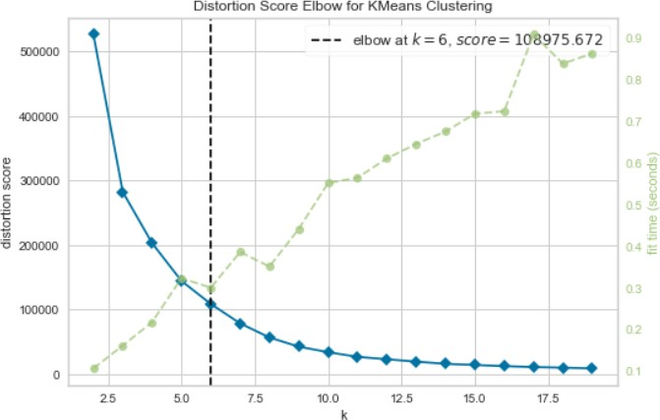
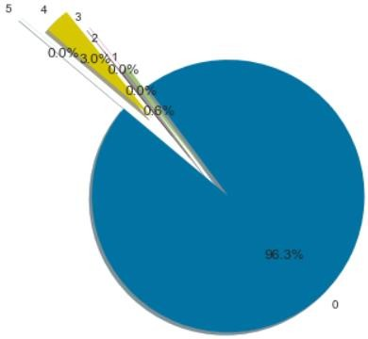
1- Choosing K-Means Cluster Number with Elbow Method
Fig.1 Distortion Score Elbow
Elbow method is used to find out exact number of clusters to both not divide information unnecessarily and add much information possible. By looking at the blue-line we can see the elbow(bend) is exactly at point k=6. Also point of infliction suggest that point k=6 is the best fitting value for K-Means clustering.
2- Clustering Experiments
There are 3 different clustering methods used in this experiment. AGNES (Agglomerative Nesting), K-Means and DBSCAN (Density-based spatial clustering of applications with noise). We used DBSCAN because our data has noise at some instances which are attributes named “Dividend Payments” and “R&D Expenses” and due to DBSCAN resulting in good performance in such instances.
Fig.2 K-Means with 6 Clusters

Slide 13
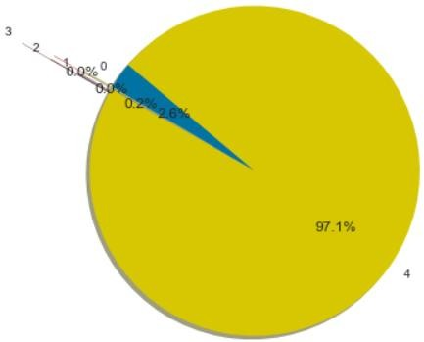
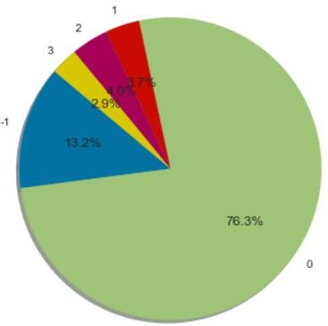
Fig.3 AGNES with 5 Clusters
Fig.4 DBSCAN with eps=0.04 and Minimum of 72 Samples

Slide 14
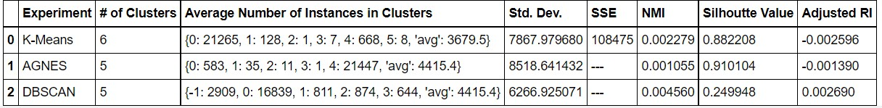
3- Evaluation Table
Table.1 Evaluation Table
It is observed from the point of Silhouette Value which is the similarity of the value to its cluster, AGNES is the best followed by K-Means. DBSCAN on the other hand performed poorly.
From the point of ARI all of the algorithms performed poorly. This can be related to most financial indicators being relevant only to themselves and ARI does not see local relevancy between these attributes. Therefore, considers the values in the clusters randomly placed.
Normalized Mutual Information values suggest high number of correct clusters for the instances. It is observed that K-Means algorithm is more reliable. Although the NMI values are too low to discriminate.
Sum of Squared Error (SSE) for K-Means can be considered normal if we assume the number of instances we have.

